Slide 1

Cost function
Neural Networks: Learning
Machine Learning

Slide 2







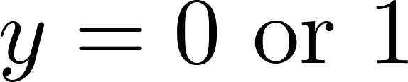
Neural Network (Classification)
total no. of layers in network
no. of units (not counting bias unit) in layer
Layer 1
Layer 2
Layer 3
Layer 4
Binary classification
1 output unit
Multi-class classification (K classes)
K output units
E.g. , , ,
pedestrian car motorcycle truck

Slide 3
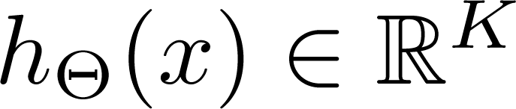
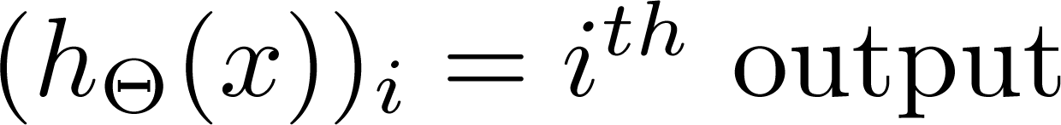
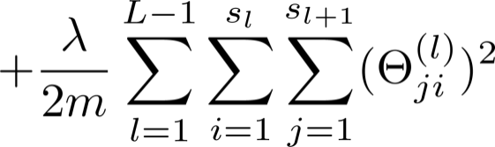
Cost function
Logistic regression:
Neural network:
输出y是一维的

Slide 4
Backpropagation algorithm
Neural Networks: Learning
Machine Learning

Slide 5
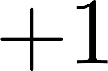


Forward Propagation
Number of neurons:
2 2 2 1

Slide 6
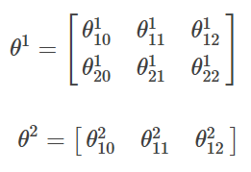
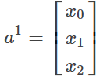














Forward Propagation
1、两个初始的权重矩阵：
$$θ_{10}^{1}$$
$$θ_{10}^{2}$$
$$θ_{20}^{1}$$
$$θ_{11}^{2}$$
$$θ_{11}^{1}$$
$$a_{1}^{2}$$
$$a_{1}^{3}$$
$$θ_{21}^{1}$$
$$θ_{12}^{2}$$
2、第一层是输入，激励就是样本的特征值；记为:
$$θ_{12}^{1}$$
$$a_{2}^{2}$$
$$θ_{22}^{1}$$
Given one training example ( , )

Slide 7
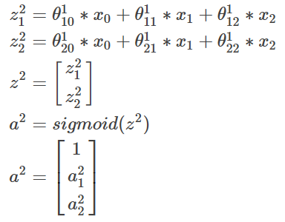
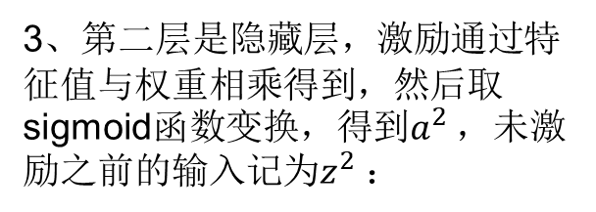

Forward Propagation
3、第二层是隐藏层，激励通过特征值与权重相乘得到，然后取sigmoid函数变换，得到$a^{2}$ ，未激励之前的输入记为$z^{2}$：
$$θ_{10}^{1}$$
$$θ_{10}^{2}$$
$$θ_{20}^{1}$$
$$θ_{11}^{2}$$
$$θ_{11}^{1}$$
$$a_{1}^{2}$$
$$a_{1}^{3}$$
$$θ_{21}^{1}$$
$$θ_{12}^{2}$$
$$θ_{12}^{1}$$
$$a_{2}^{2}$$
$$θ_{22}^{1}$$
在上面，我们最后加上了偏置项。

Slide 8
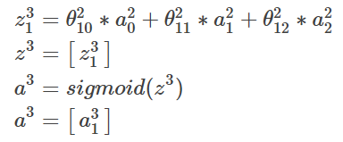
Forward Propagation
4、第三层是输出层：
$$θ_{10}^{1}$$
$$θ_{10}^{2}$$
$$θ_{20}^{1}$$
$$θ_{11}^{2}$$
$$θ_{11}^{1}$$
$$a_{1}^{2}$$
$$a_{1}^{3}$$
$$θ_{21}^{1}$$
$$θ_{12}^{2}$$
$$θ_{12}^{1}$$
因为是输出层了，所以不需要再往下计算，所以不加偏置项。
$$a_{2}^{2}$$
$$θ_{22}^{1}$$
前向传递输入信号直至输出产生误差

Slide 9
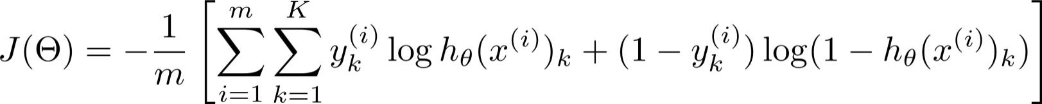
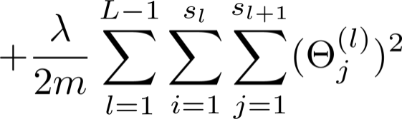
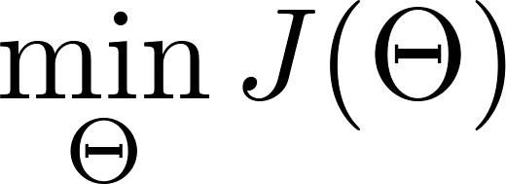
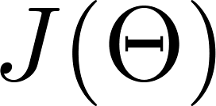
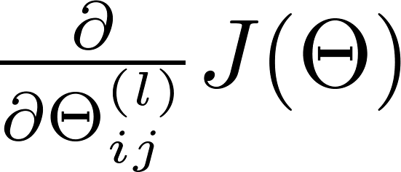
Gradient computation
Need code to compute:

Slide 10
Back Propagation
Question: 为什么会提出反向传播算法，直接应用梯度下降不行吗？
答案是不行的。
纵然梯度下降神通广大，但却不是万能的。梯度下降可以应对带有明确求导函数的情况，或者说可以应对那些可以求出误差的情况，比如逻辑回归，我们可以把它看作是没有隐含层的网络。
但对于含有多个隐含层的神经网络，在输出层可以直接求出误差来更新参数，但其中隐含层的误差是不存在的，因此不能对它直接应用梯度下降，而是先将误差反向传播至隐含层，然后再应用梯度下降 。

Slide 11








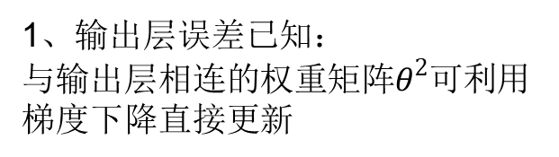







Back Propagation
如何将输出层的误差反向传播给隐含层？
1、输出层误差已知：
与输出层相连的权重矩阵$θ^{2}$可利用梯度下降直接更新
$$e_{1}^{3}$$
2、接下来对隐含层节点作误差分析，计算隐含层的间接误差
$$e_{1}^{2}$$
$$θ_{11}^{1}$$
$$θ_{11}^{2}$$
$$a_{1}^{2}$$
$$a_{1}^{3}$$
$$θ_{21}^{2}$$
$$θ_{21}^{1}$$
$$e_{2}^{3}$$
$$θ_{12}^{1}$$
$$θ_{12}^{2}$$
$$a_{2}^{2}$$
$$a_{2}^{3}$$
$$θ_{22}^{1}$$
$$θ_{22}^{2}$$
3、根据求得的误差来更新参数

Slide 12
补充知识：sigmoid函数求导

Slide 13
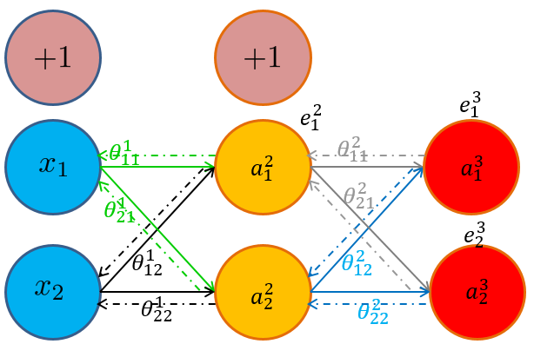




3.1、更新权重$θ_{11}^{2}$
根据链式法则，误差对$θ_{11}^{2}$求偏导如下：
同理：
更新$θ_{12}^{2}$
更新$θ_{10}^{2}$

Slide 14



3.2、更新权重$θ_{11}^{1}$
误差对$θ_{11}^{1}$求偏导如下：
求得偏导之后，利用梯度下降更新权重$θ_{11}^{1}$：

Slide 15



4.1、引入记号$δ$
$δ_{j}^{l}$：第l层第j个神经元上的“误差”
利用链式法则更新权重的方法简单清晰，但过于冗长，每次更新的时候都需要重新计算节点的误差，存在一些不必要的重复计算。
输出层的“误差”：
隐含层的“误差”：

Slide 16
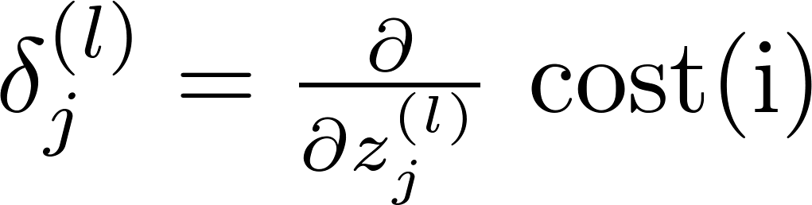


4.2、$δ的$含义
Formally, (for ), where

Slide 17
5、用矩阵表示
Layer 1
Layer 2
Layer 3
Layer 4
含义：
l 代表目前所计算的是第几层。
j 代表目前计算层中的激活单元的下标，也将是下一层的第 j个输入变量的下标。
i 代表下一层中误差单元的下标，是受到权重矩阵中第 i 行影响的下一层中的误差单元的下标 。
上式为不做正则化处理的结果

Slide 18
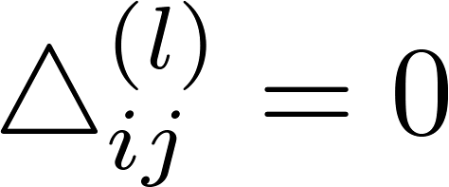


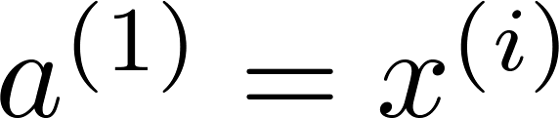

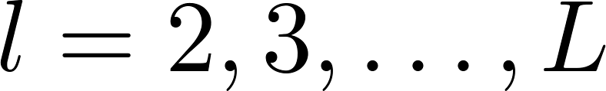

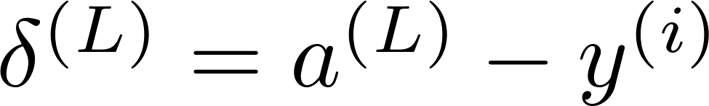
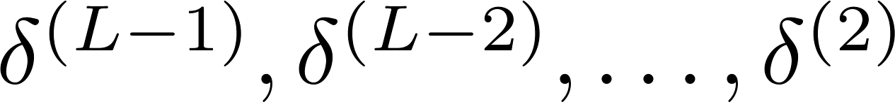
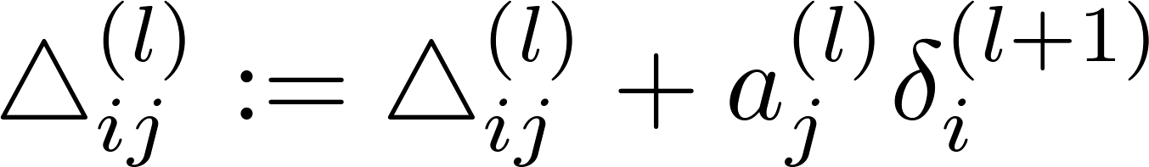

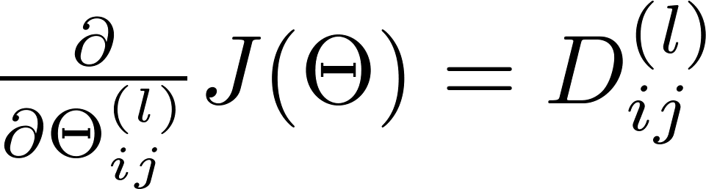
Backpropagation algorithm
Training set
Set (for all ).
For
Set
Perform forward propagation to compute for
Using , compute
Compute

Slide 19
Implementation note: Unrolling parameters
Neural Networks: Learning
Machine Learning

Slide 20
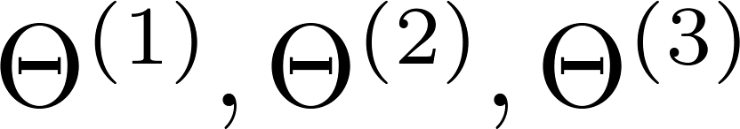
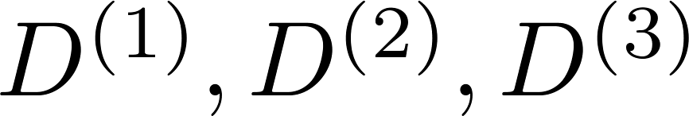
Advanced optimization
function [jVal, gradient] = costFunction(theta)
optTheta = fminunc(@costFunction, initialTheta, options)
…
Neural Network (L=4):
- matrices (Theta1, Theta2, Theta3)
- matrices (D1, D2, D3)
“Unroll” into vectors

Slide 21

Example
thetaVec = [ Theta1(:); Theta2(:); Theta3(:)];
DVec = [D1(:); D2(:); D3(:)];
Theta1 = reshape(thetaVec(1:110),10,11);
Theta2 = reshape(thetaVec(111:220),10,11);
Theta3 = reshape(thetaVec(221:231),1,11);

Slide 22

Learning Algorithm
Have initial parameters .
Unroll to get initialTheta to pass to
fminunc(@costFunction, initialTheta, options)
function [jval, gradientVec] = costFunction(thetaVec)
From thetaVec, get .
Use forward prop/back prop to compute and .
Unroll to get gradientVec.

Slide 23
Gradient checking
Neural Networks: Learning
Machine Learning

Slide 24
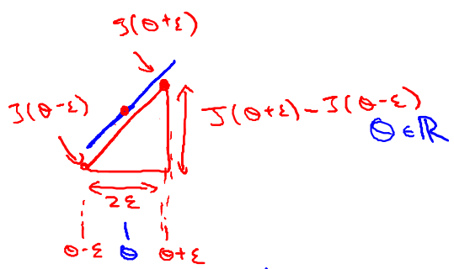

Numerical estimation of gradients
采用双边求导，对梯度进行估计：
Implement: gradApprox = (J(theta + EPSILON) – J(theta – EPSILON)) /(2*EPSILON)

Slide 25

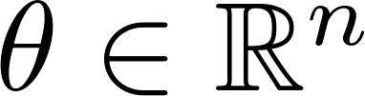
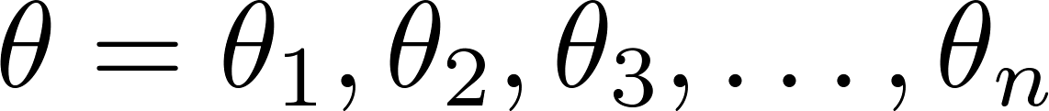
Parameter vector
(E.g. is “unrolled” version of )

Slide 26
for i = 1:n,
thetaPlus = theta;
thetaPlus(i) = thetaPlus(i) + EPSILON;
thetaMinus = theta;
thetaMinus(i) = thetaMinus(i) – EPSILON;
gradApprox(i) = (J(thetaPlus) – J(thetaMinus))
/(2*EPSILON);
end;
Check that gradApprox ≈ DVec
From
Numerical estimation
From
back propogation

Slide 27
Implementation Note:
Implement backprop to compute DVec (unrolled ).
Implement numerical gradient check to compute gradApprox.
Make sure they give similar values.
Turn off gradient checking. Using backprop code for learning.
Important:
Be sure to disable your gradient checking code before training your classifier. If you run numerical gradient computation on every iteration of gradient descent (or in the inner loop of costFunction(…))your code will be very slow.
DVec

Slide 28
Random initialization
Neural Networks: Learning
Machine Learning

Slide 29

Initial value of
For gradient descent and advanced optimization method, need initial value for .
optTheta = fminunc(@costFunction, initialTheta, options)
Consider gradient descent
Set ?
initialTheta = zeros(n,1)

Slide 30
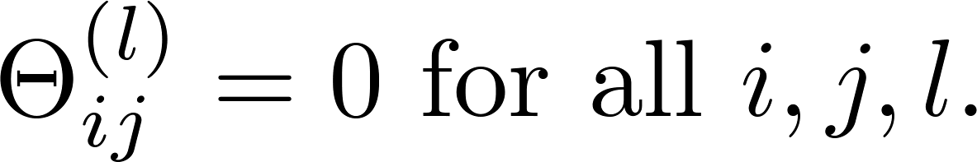



Zero initialization
After each update, parameters corresponding to inputs going into each of two hidden units are identical.

Slide 31
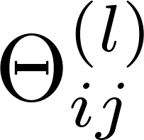
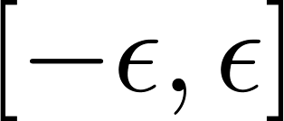
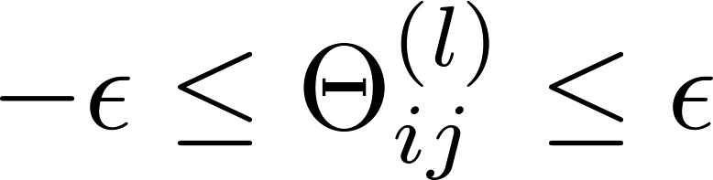
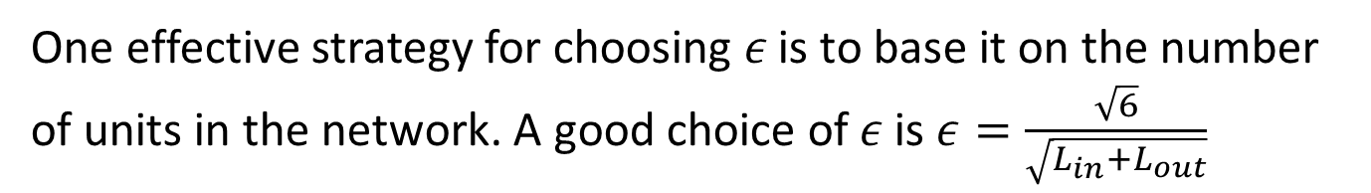
Random initialization: Symmetry breaking
Initialize each to a random value in
(i.e. )
E.g.
Theta1 = rand(10,11)*(2*INIT_EPSILON)
- INIT_EPSILON;
Theta2 = rand(1,11)*(2*INIT_EPSILON) - INIT_EPSILON;
One effective strategy for choosing $ε$is to base it on the number of units in the network. A good choice of$ε$ is $ε=\frac{\sqrt{6}}{\sqrt{L_{in}+L_{out}}}$

Slide 32
Putting it together
Neural Networks: Learning
Machine Learning

Slide 33

Training a neural network
Pick a network architecture (connectivity pattern between neurons)
No. of input units: Dimension of features
No. output units: Number of classes
Reasonable default: 1 hidden layer, or if >1 hidden layer, have same no. of hidden units in every layer (usually the more the better)

Slide 34
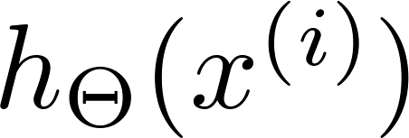

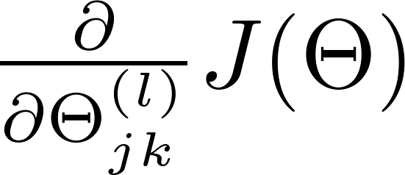
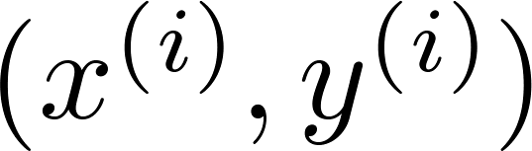

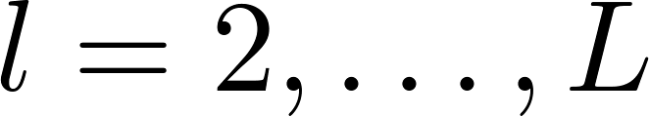
Training a neural network
Randomly initialize weights
Implement forward propagation to get for any
Implement code to compute cost function
Implement backprop to compute partial derivatives
for i = 1:m
Perform forward propagation and backpropagation using example
(Get activations and delta terms for ).

Slide 35

Training a neural network
Use gradient checking to compare computed using backpropagation vs. using numerical estimate of gradient of . Then disable gradient checking code.
Use gradient descent or advanced optimization method with backpropagation to try to minimize as a function of parameters

Slide 36
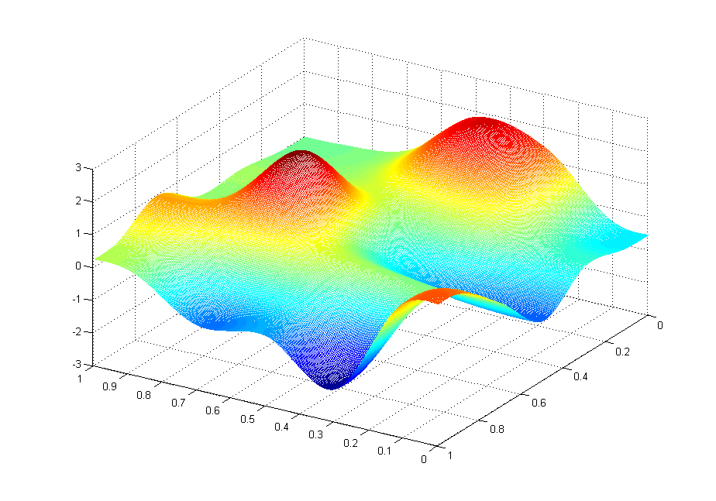



Slide 37

第6、7章 神经网络重点
神经网络的模型表示，包括每个参数的意义
神经网络处理分类问题，样本标签y的维度及取值
对神经网络计算偏导时，为什么要提出反向传播算法，直接应用梯度下降不行吗？
神经网络前向传播的过程、反向传播、偏导的计算、
的含义等
神经网络参数theta为什么要采用随机初始化？而不能初始化为0？
了解训练一个网络的过程步骤

